Slide 1
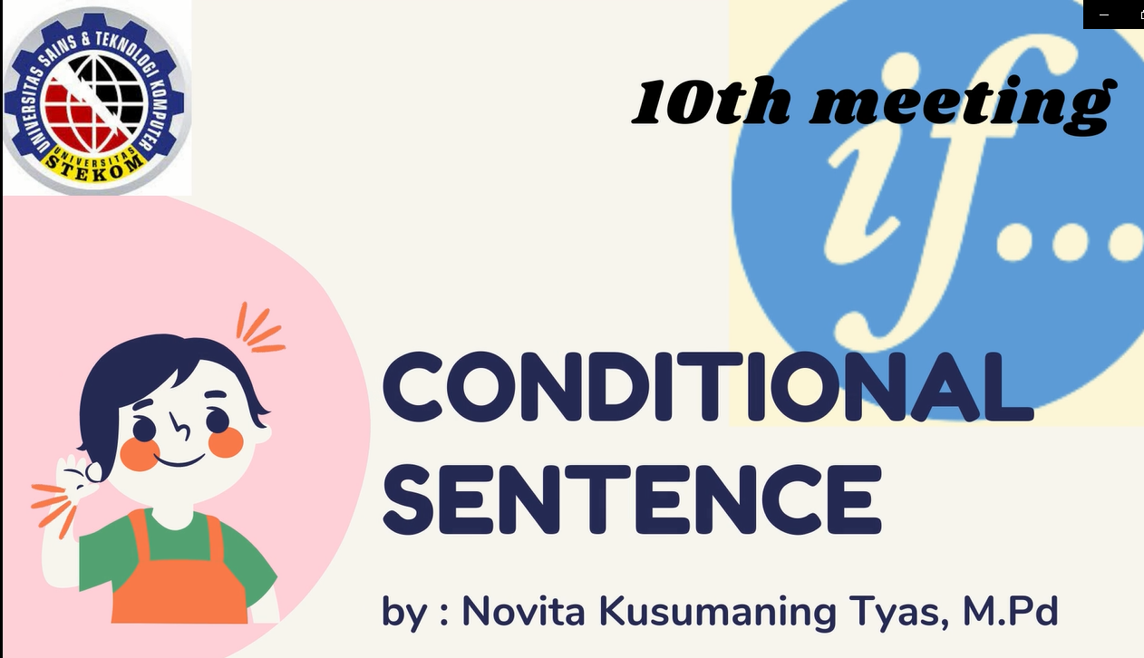

Slide 2
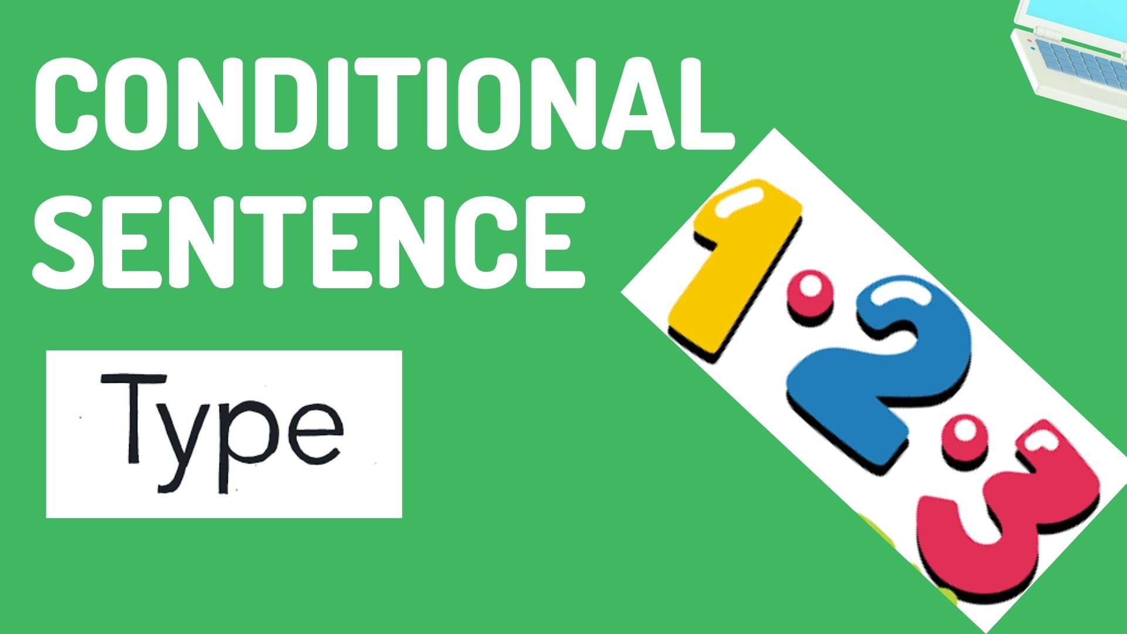

Slide 3
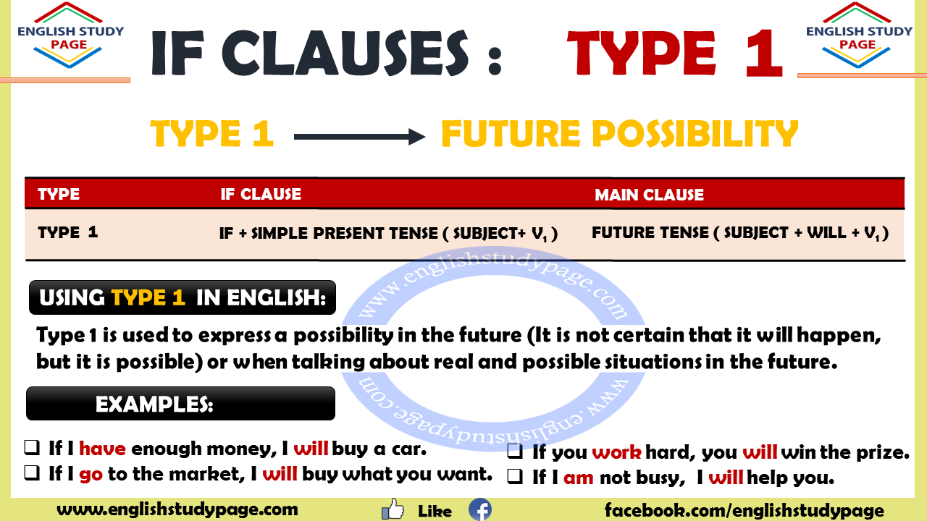

Slide 4
Using Type 1:
The conditional sentences indicate us a possible condition and its probable result. It means that the expected actions depends on a condition. If Clauses – Type 1 is used to express a possibility in the future (It is not certain that it will happen, but it is possible). We use this type when talking about real and possible situations in the future.
Examples:
If I have enough money (if clause) , I will buy a car. (Main Clause)
If we see her, we will tell her what the teacher said.
If I go to the market, I will buy what you want.
If I pass the exam, I will organize a celebration party.
If you feel bad, you must go to the doctor.
Using Type 1 in QUESTIONS
Examples:
What will you do if you lose the match? If I lose the match, I will work hard more
Can you call me if you see Susan? If I see Susan, I will call you.
Will you leave school if you don’t have enough money? If I don’t have enough money, I will not leave school
Can you tell her to see me if she call you?

Slide 5
1. The sentence can begin with an if clause or a main clause. If the sentence begins with an ‘if clause’, put a comma between the if clause and the main clause.
(If) + (Present tense, or etc.) + (,) + (Future tense or etc.)
(Future tense or etc.)+ (if) + (Present tense, or etc.)
Examples:
If he is late again, I’ll be very angry. / I’ll be very angry if she is late.
If you write me, I will write you. / I will write you if you write me.
If I get up early, I will call you. / I will call you if I get up early.
2. In if clauses- type 1, we can use imperatives.
Examples:
If you see Mr Steven, give him my regards.
If the machine doesn’t work, push this button twice.
If you go to the market, buy me an ice cream.

Slide 6
3. If you want, we can use modals in both ‘ıf clause’ and ‘main clause’ or you can use modals only in one part.
Examples:
If I can sleep early, I can get up early.
If you can speak English, you will find jobs easily.
If there should be a chaos in the country, it may affect the country economically.
4. In some cases, present continuous tense, present perfect tense and present perfect continuous tense can be used in ‘If Clause‘
Examples:
If he is still talking on the phone, tell him to hang up the phone.
If my mother has cooked the meal, I’ll eat my food.
If she has been studying since 9 o’clock, she will need to take a break.
5. One or two of the clauses may be negative in Type 1
Examples:
If you do not come, I will not go to the party.
If it doesn’t snow, the roads will be open.
If you love me, I won’ upset you.

Slide 7
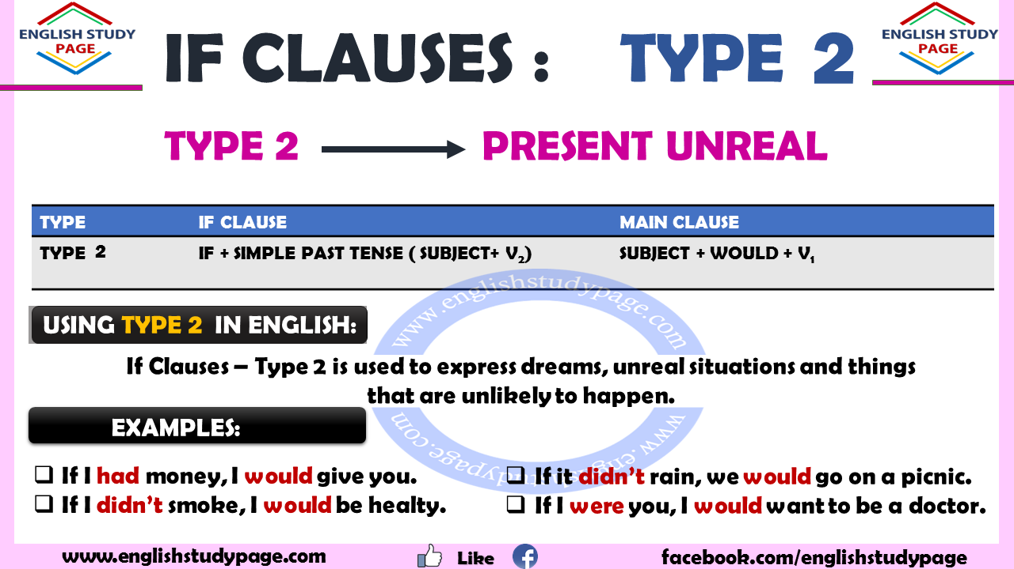

Slide 8
Using Type 2:
The conditional sentences indicate us a possible condition and its probable result. It means that the expected actions depends on a condition. If Clauses – Type 2 is used to express dreams, unreal situations and things that are unlikely to happen. In other words, The condition specified in the clause is not actual but is a condition that is currently being imagined. Although the verb is used in the past, we use type 2 when talking about present time or now.
Examples:
If I had money (if clause), I would give you(main clause). ( but I don’t have money)
If she knew the answer, she would win the prize. ( but she doesn’t know the answer)
If I didn’t smoke, I would be healty. ( but I smoke so I am not healty)
If he had enough experience fort he job, the boss could hire him. ( but he doesn’t )

Slide 9
1. The sentence can begin with an if clause or a main clause. If the sentence begins with an ‘if clause’, put a comma between the if clause and the main clause.
If + past tense, or could + (,) + present unreal conditional ( would or modals )
Present unreal conditional ( would or modals ) + if + past tense, or could
Examples:
If I went to Paris, I would see the Eiffel Tower. / I would see the Eiffel Tower if I went to Paris.
If you had a n invitation card, you should go to the party. / You should go to the party if you had an invitation card.
If we used the time properly, we would finish our project. / we would finish our project if we used the time properly
2. If you want, we can use modals in both ‘ıf clause’ and ‘main clause’ or you can use modals only in one part.
Examples:
If I had enough experience fort he job, the boss could hire him.
If I could speak English very well, I would look for a job in foreign companies.
If I understood what the teacher said, I could tell you.

Slide 10
3. In ‘If Clauses Type 2’, we usually use ‘were’ which is past form of ‘to be’ instead of ‘was’ although the pronoun is ‘I, he, she or it’.
Examples:
If I were you, I wouldn’t marry with him.
If she were ill, she couldn’t attend the meeting.
If it weren’t snowy, I would go out.
4. In Type 2, one or two of the clauses can be negative
Examples:
If I woke up late, I wouldn’t I be aware of what happened.
If my mother did not remind me, I would forget my worksheet at home.
If she were angry, she wouldn’t not talk to us.
5. Using Type2 in questions
Examples:
What would happen if humans disappeared?
What would we do firstly if a fire broke out?
Would you cry if he left you?

Slide 11
6. Tenses and structures can be used in If Clauses- Type 2 are given below:
In If Clause; past form of to be, past continuous tense, should, could and had to are also used.
Examples:
If you were clever, you would understand what I meant.
If he could come here, they would show him something that you would like.
7. Would can be written short as ‘d’. You can always use this abbreviation.
Example:
If you lost time, you would ( you’d ) miss the bus.

Slide 12
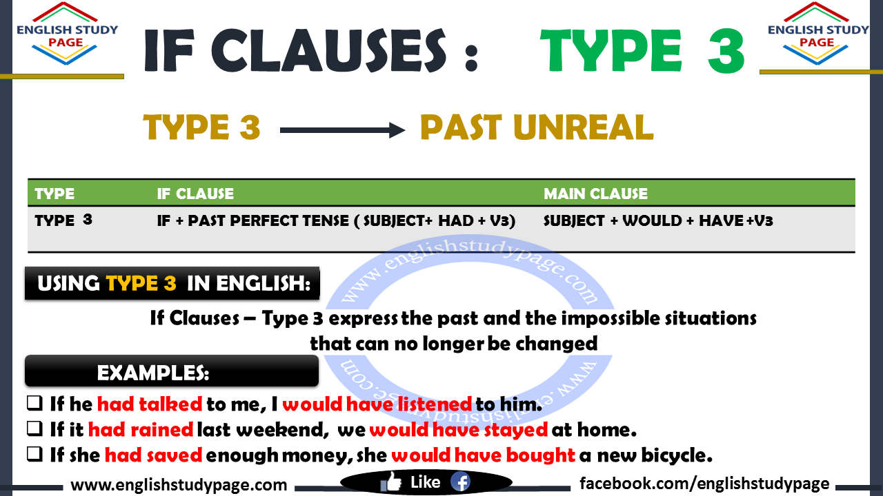

Slide 13
Using Type 3:
The conditional sentences indicate us a possible condition and its probable result. It means that the expected actions depends on a condition. If Clauses – Type 3 is used to express the past and the impossible situations that can no longer be changed. In other words, The condition specified in the clause is imaginary or unreal or impossible condition in the past that did not happen.
Examples:
If he had talked to me, I would have listened to him. ( but he didn’t talk to me )
If it had rained last weekend, we would have stayed at home. ( but it didn’t rain last weekend)
If she had saved enough money, she would have bought a new bicycle. ( but she didn’t save enough money )

Slide 14
1. The sentence can begin with an if clause or a main clause. If the sentence begins with an ‘if clause’, put a comma between the if clause and the main clause.
(If) + (past tense, or could ) + (,) + ( present unreal conditional (would) or modals)
(present unreal conditional (would) or modals ) + (if) + (past tense, or could)
Examples:
If I had studied, I would have passed the exam. (or) I would have passed the exam if I had studied.
If the museum had been open, we would have seen many different handworks. (or) We would have seen many different handworks if the museum had been open.
If the child had had breakfast, she would have been active. (or) She would have been active if the child had had breakfast.
2. If you want, we can use modals in both ‘ıf clause’ and ‘main clause’ or you can use modals only in one part.
Examples:
If I had had the power, I might have looked after myself.
If my son could have taken the English course, he could have passed the exam.
If she could have gone to Mexico, she would have seen the best friends.

Slide 15
3. In Type 3, one or two of the clauses can be negative
Examples:
If I had passed my exam, I would not ( wouldn’t ) have been sad.
If you had not ( hadn’t ) listened to me, you would n’t have been successful.
If she hadn’t fallen off the bicycle, she would have arrived at the school in time.
4. Using Type3 in questions
Examples:
What would have happen if there hadn’t been any electricity in our lives?
Would you have helped me if you had had time?
Wouldn’t you have studied hard if I hadn’t warned you?
What would you have done if you had had lots of money?

Slide 16
Type 1
if + S + Verb1, Subject + Will + Verb 1
Type 2
If + S + Verb 2, Subject + would + verb 1
Only use “were”
Type 3
If + S + Had + Verb3, Subject + would + have + Verb3
We can omit if
Had+ S+ Verb 3, Subject + would + have + verb 3

